Slide 1
Discrete Random Variables

Slide 2

Probability mass function
From the distribution function over Ω, we can derive the probability mass function (pmf) of X, i.e., the function p(x) : X(Ω)→ [0,1] which assigns to all possible values of X its probability
The pmf satisfies the normalization constraint:
The pmf can be described by a probability table
X | x₁ | x₂ | ... | x_{M}
P(X=x) | p(x₁) | p(x₂) | ... | p(x_{M})

Slide 3

Cumulative distribution function
The probability that a random variable takes values smaller or equal to x is called cumulative probability.
The function F(x): Ω → [0,1] assigning to all possible values of X their cumulative probability is called cumulative distribution function (cdf).

Slide 4
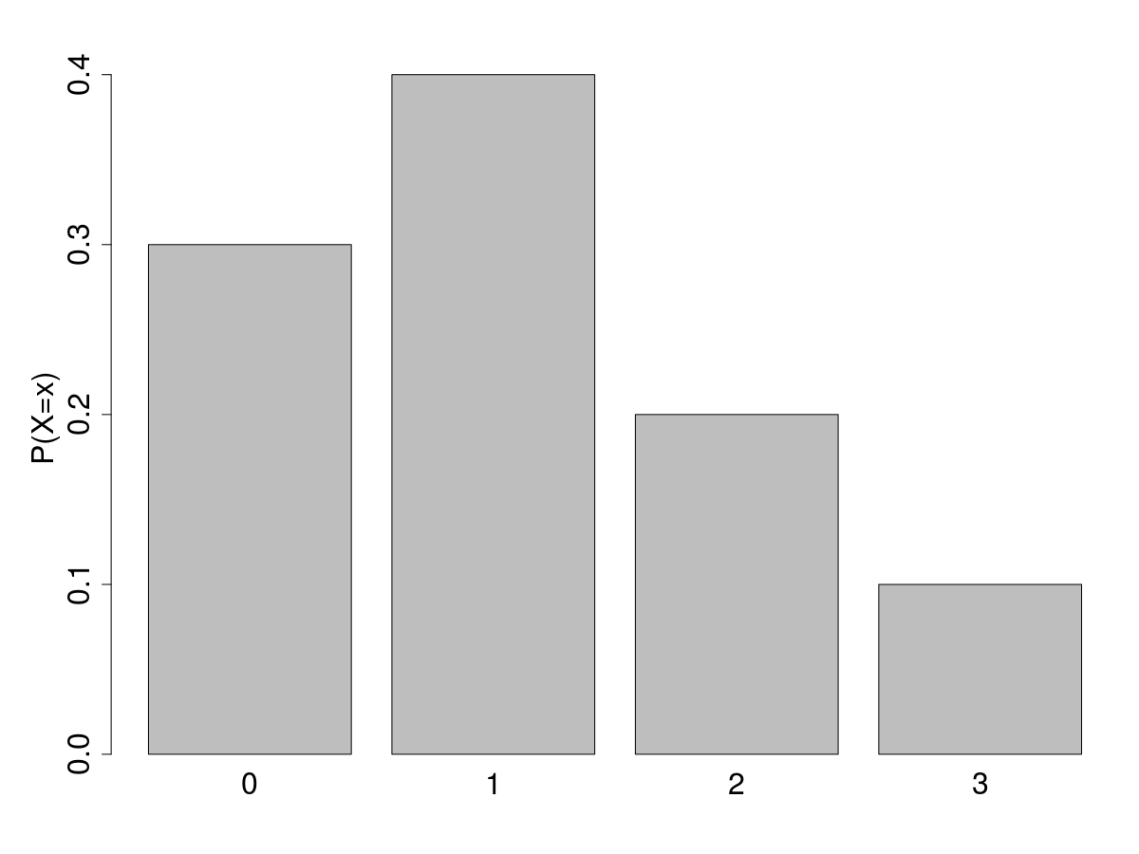
Cumulative distribution function
The figure represents the probability distribution of X.
Write the PMF and CDF of X.

Slide 5
Cumulative mass function
The figure represents the probability distribution of X.
Write the PMF and CDF of X.
X | PMF: P(X=x)
0 | 0.3
1 | 0.4
2 | 0.2
3 | 0.1

Slide 6
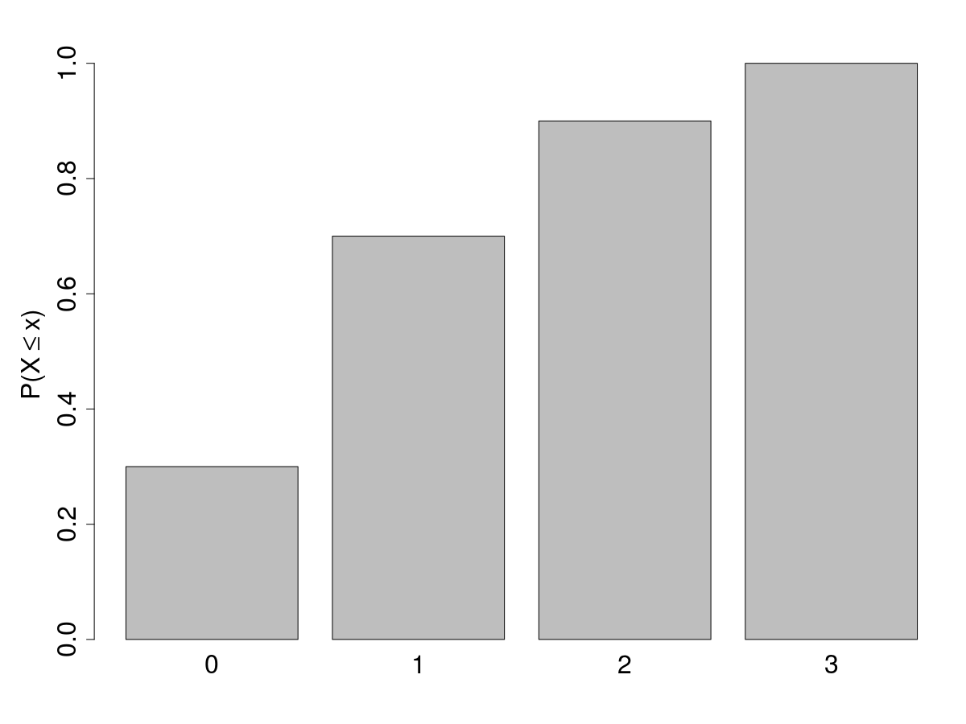
Cumulative mass function
The figure represents the probability distribution of X.
Write the PMF and CDF of X.
X | PMF: P(X=x) | CDF: P(X<x)
0 | 0.3 | 0.3
1 | 0.4 | 0.7
2 | 0.2 | 0.9
3 | 0.1 | 1

Slide 7

Cumulative distribution function
The CDF is meaningful only for ordinal random variables
F(x) is a non decreasing function

Slide 8
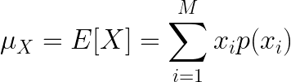
Expected value
of a discrete random variable
As for population variables, we are often interested in providing a summary measure of the central position and spread (or variability) of a random variable
We measure the central position by the expected value (or expectation or mean), which is a weighted average of the possible outcomes

Slide 9
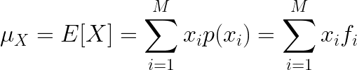
Expected value of X
Example
Randomly sampling from a population
We are interested in the expected value of attribute X of the randomly sampled individual.
The probability of each possible value x_{i} of rv X is given by its frequency f_{i}
Then,
which is equal to the population mean value of X.

Slide 10
Expected value
of a discrete random variable
In a game of cards you win $1 if you draw a heart, $5 if you draw an ace (including the ace of hearts), $10 if you draw the king of spades and nothing for any other card you draw. Write the probability model for your winnings, and calculate your expected winning.

Slide 11
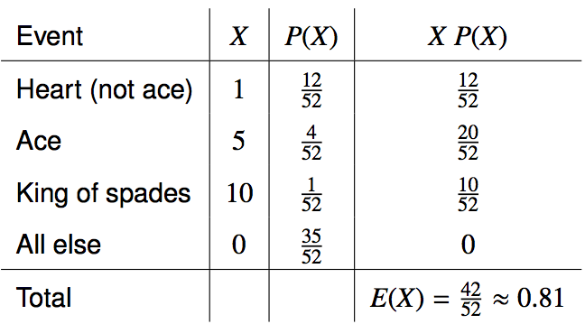
Expected value
of a discrete random variable
In a game of cards you win $1 if you draw a heart, $5 if you draw an ace (including the ace of hearts), $10 if you draw the king of spades and nothing for any other card you draw. Write the probability model for your winnings, and calculate your expected winning.

Slide 12
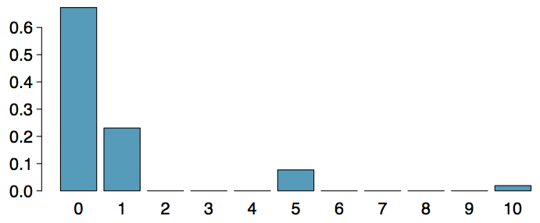
Expected value
of a discrete random variable (cont.)
Below is a visual representation of the probability distribution of winnings from this game:

Slide 13
Practice
A casino game costs $5 to play. If you draw first a red card, then you get to draw a second card. If the second card is the ace of hearts, you win $500. If not, you don't win anything, i.e. lose your $5. What is your expected profits (or losses) from playing this game? Remember: profit (or loss) = winnings - cost.
(a) a loss of 10¢ (c) a loss of 30¢
(b) a loss of 25¢ (d) a profit of 5¢

Slide 14
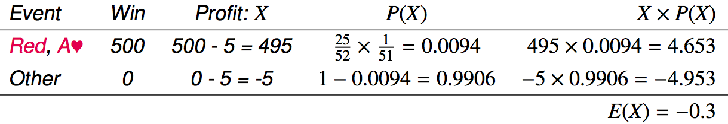
Practice
A casino game costs $5 to play. If you draw first a red card, then you get to draw a second card. If the second card is the ace of hearts, you win $500. If not, you don't win anything, i.e. lose your $5. What is your expected profits (or losses) from playing this game? Remember: profit (or loss) = winnings - cost.
(a) a loss of 10¢ (c) a loss of 30¢
(b) a loss of 25¢ (d) a profit of 5¢

Slide 15
Expected value of a function of X
Sometimes we are interested in a function g(X) of X.
Example: Assume to play a second round of the game of card above, where the gain for each draw is squared. What is the expected winning now?
E[X²] = E[Y]
= 0・35/52 + 1・12/52 + 25・4/52 + 100・1/52
= 0²・35/52 + 1²・12/52 + 5²・4/52 + 10²・1/52
= 212/52
X | P(X) | Y = X²
0 | 35/52 | 0
1 | 12/52 | 1
5 | 4/52 | 25
10 | 1/52 | 100

Slide 16

Expected value of a function of X
In general, it holds:

Slide 17
Expected value of a function of X
The yearly maintenance cost of machine A is given by g(X) = 100X where X is a rv representing the number of faults per year. What is the expected yearly maintenance cost for a machine with the distribution of yearly faults given in the table below?
x | p(x)
0 | 0.85
1 | 0.1
2 | 0.05

Slide 18
Properties of E[X]
If a ≤ x ≤ b then a ≤ E[x] ≤ b The expected value of a RV cannot be larger than its maximum value nor smaller than if minimum.
E[c] = c The expected value of a constant is the constant itself
Linearity of expectation: E[aX+b] = aE[X]+b The expected value of a linear transformation of X is equal to the same linear transformation applied to E[X].

Slide 19
Linear combinations
A linear combination of random variables X and Y is given by
aX + bY
where a and b are some fixed numbers.

Slide 20

Linear combinations
A linear combination of random variables X and Y is given by
aX + bY
where a and b are some fixed numbers.
The average value of a linear combination of random variables is given by
E(aX + bY) = a⋅E(X) + b⋅E(Y)
In general,

Slide 21
Calculating the expectation
of a linear combination
On average you take 10 minutes for each statistics homework problem and 15 minutes for each chemistry homework problem. This week you have 5 statistics and 4 chemistry homework problems assigned. What is the total time you expect to spend on statistics and physics homework for the week?

Slide 22
Calculating the expectation
of a linear combination
On average you take 10 minutes for each statistics homework problem and 15 minutes for each chemistry homework problem. This week you have 5 statistics and 4 chemistry homework problems assigned. What is the total time you expect to spend on statistics and physics homework for the week?
TOTAL TIME = S₁+S₂+S₃+S₄+S₅+C₁+C₂+C₃+C₄
E[TOTAL TIME] = E[S₁] + E[S₂] + … + E[C₁] + ...
= 5E[S] + 4 E[C] = 5・10 + 4・15 = 100
Note: The total time is NOT 5S+4C! This will make a difference in the computation of the variance

Slide 23
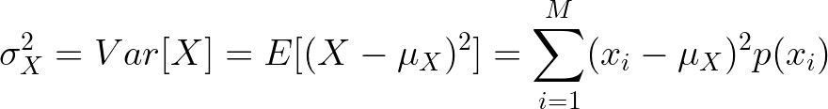


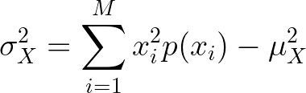
Variability
We measure the variability of a random variable by its variance and standard deviation.
It can be proven that
Then, the variance can be computed using the simpler expression

Slide 24
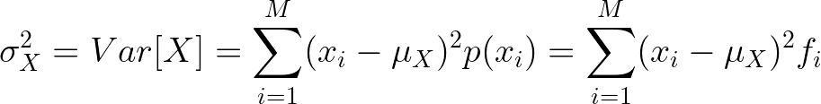
Variance of X
Example
Randomly sampling from a population
As for the expected value, the variance of rv X describing an attribute of the randomly sampled individual is equal to the population variance of that attribute

Slide 25
Variability of
a discrete random variable
For the previous card game example, how much would you expect the winnings to vary from game to game?

Slide 26
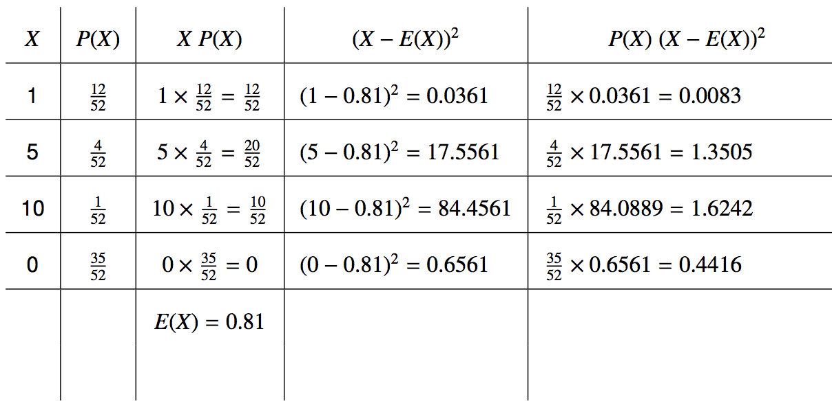
Variability of
a discrete random variable
For the previous card game example, how much would you expect the winnings to vary from game to game?

Slide 27


Variability of
a discrete random variable
For the previous card game example, how much would you expect the winnings to vary from game to game?

Slide 28

Properties of the variance
Variance of a constant: V[b] = 0
Variance of a linear function: V[aX+b] = a²V[X]
The variance of a linear combination of two independent random variables is calculated as:

Slide 29
Linear combinations
The standard deviation of the time you take for each problem of statistics is 1.5 minutes, and it is 2 minutes for each chemistry problem. What is the standard deviation of the time you expect to spend on statistics and chemistry homework for the week if you have 5 statistics and 4 chemistry homework problems assigned?

Slide 30
Linear combinations
The standard deviation of the time you take for each problem of statistics is 1.5 minutes, and it is 2 minutes for each chemistry problem. What is the standard deviation of the time you expect to spend on statistics and chemistry homework for the week if you have 5 statistics and 4 chemistry homework problems assigned?
V[S₁+S₂+S₃+S₄+S₅+C₁+C₂+C₃+C₄]=
= V[S₁]+V[S₂]+V[S₃]+V[S₄]+V[S₅]+V[C₁]+V[C₂]+V[C₃]+V[C₄]
= 5V[S]+4V[C]
= 5⋅1.5² + 4⋅2² = 27.25

Slide 31
Adding or multiplying?
A company has 5 Lincoln Town Cars in its fleet. Historical data show that annual maintenance cost for each car is on average $2,154 with a standard deviation of $132. What is the mean and the standard deviation of the total annual maintenance cost for this fleet?

Slide 32
Adding or multiplying?
A company has 5 Lincoln Town Cars in its fleet. Historical data show that annual maintenance cost for each car is on average $2,154 with a standard deviation of $132. What is the mean and the standard deviation of the total annual maintenance cost for this fleet?
Note that we have 5 cars each with the given annual maintenance cost (X1 + X2 + X3 + X4 + X5), not one car that had 5 times the given annual maintenance cost (5X).

Slide 33
Adding or multiplying?
A company has 5 Lincoln Town Cars in its fleet. Historical data show that annual maintenance cost for each car is on average $2,154 with a standard deviation of $132. What is the mean and the standard deviation of the total annual maintenance cost for this fleet?
Note that we have 5 cars each with the given annual maintenance cost (X1 + X2 + X3 + X4 + X5), not one car that had 5 times the given annual maintenance cost (5X).

Slide 34
Adding or multiplying?
A company has 5 Lincoln Town Cars in its fleet. Historical data show that annual maintenance cost for each car is on average $2,154 with a standard deviation of $132. What is the mean and the standard deviation of the total annual maintenance cost for this fleet?
Note that we have 5 cars each with the given annual maintenance cost (X1 + X2 + X3 + X4 + X5), not one car that had 5 times the given annual maintenance cost (5X).

Slide 35

Chebyshev's inequality
Chebyshev's proved that if σ is finite and strictly positive (>0), then it holds:

